Slide 1
ROUND KEY-BASED HYBRID CRYPTOGRAPHY SYSTEM
Team Details
Megha Parate (20EG105425)
Are Jagannath Rao (20EG105456)
Bharath Kandimalla (20EG105457)
Project Supervisor
B. Ravinder Reddy
Assistant Professor
Dept. of CSE

Slide 2
Introduction
The "Round key-based hybrid cryptography system" is a combination of two classical ciphers Vigenere and polybius ciphers, we introduce a round key as an additional layer of security.
The development environment is Python 3.10
It allows confidential information to be securely encrypted, ensuring privacy and confidentiality during data transmission.
The applications span various domains, including secure communication, sensitive documents, secure file sharing, etc.

Slide 3
Problem Statement
The Combination of the Vigenere and Polybius ciphers in a hybrid cryptographic system provides a foundation for secure data communication. However, this system is vulnerable to frequency analysis attack, kasiski attack which exploit patterns in the ciphertext to deduce the underlying plaintext.

Slide 4
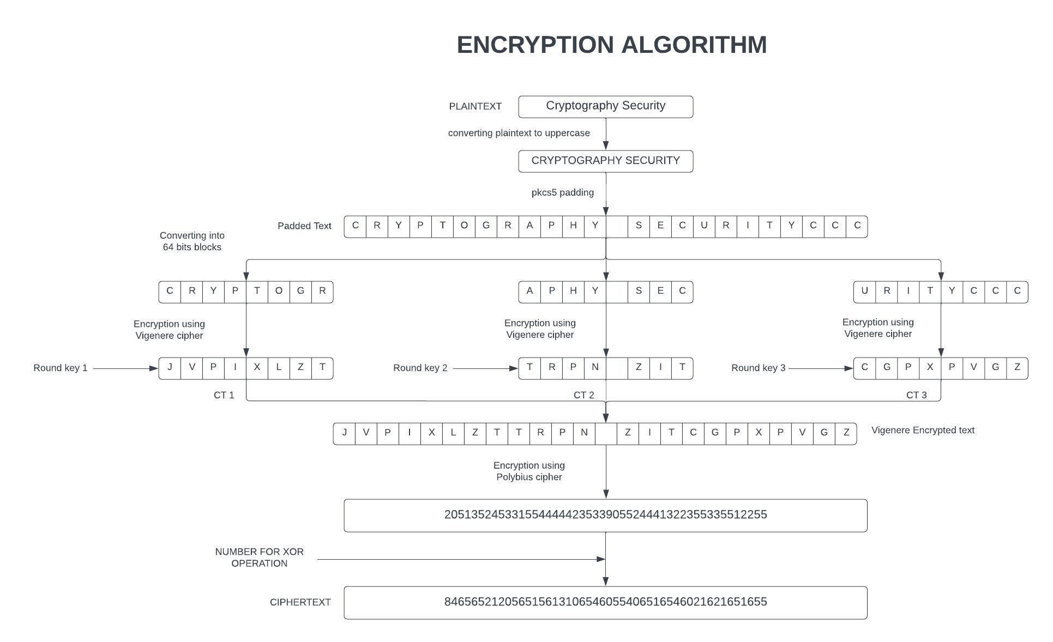
Proposed Method
The proposed method is “Round key based hybrid cryptography system”.
INPUTS: Plaintext, Key.--
Key input: SATURDAY
Processed Key: SATURDAYSATURDAYSATUR
Random numbers generated: 19, 6, 12
Round keys generated:
Round key 1: TURSATUR
Round key 2: DAYSATUR
Round key 3: URDAYSAT

Slide 5
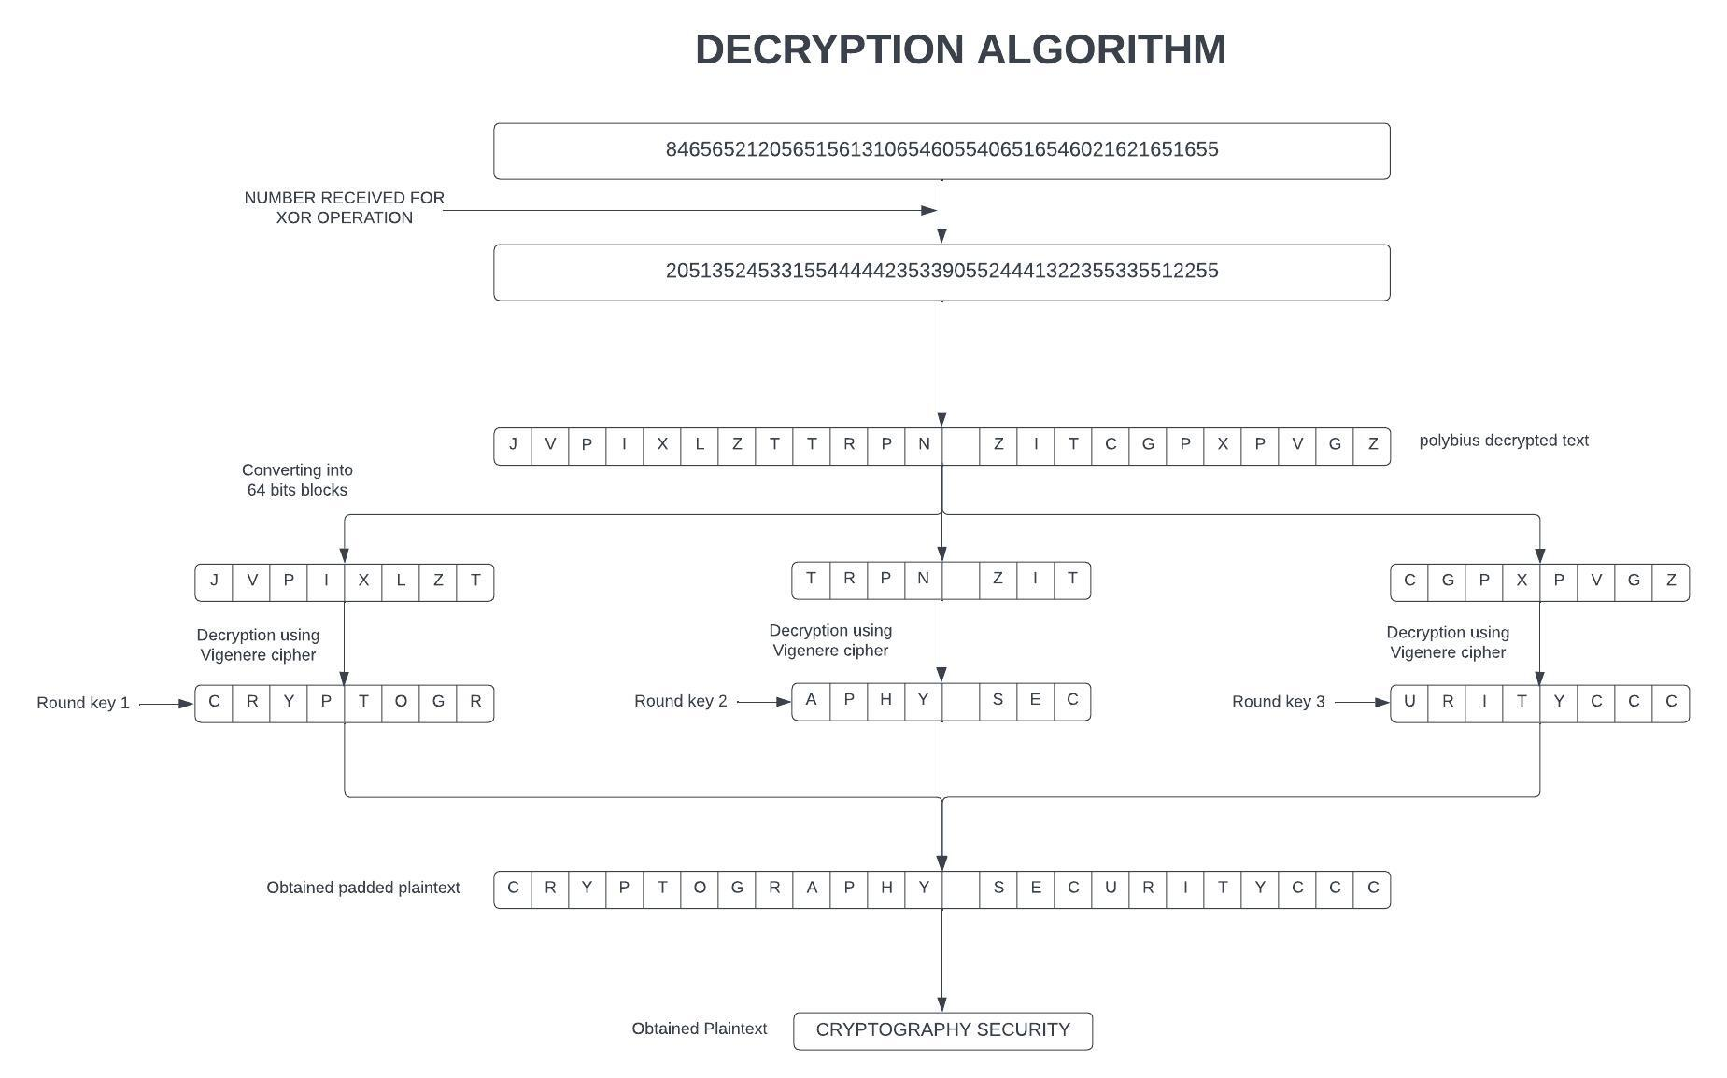
Proposed Method

Slide 6
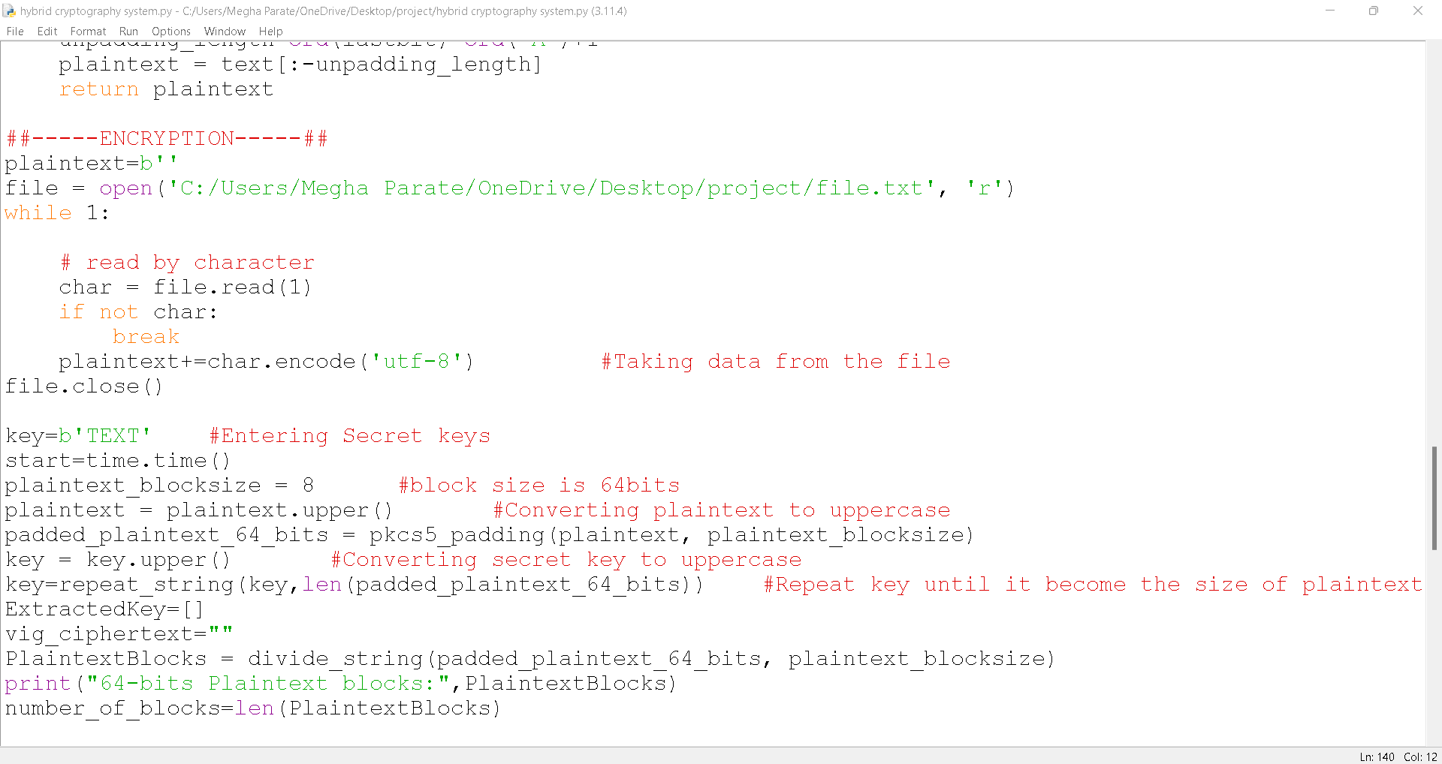
Experiment Environment
Experiment Environment used is IDLE
Used Random package for generating round number through which we generate round keys.
Used time package to analyze encryption and decryption time.
Taking file input of message to be sent.

Slide 7
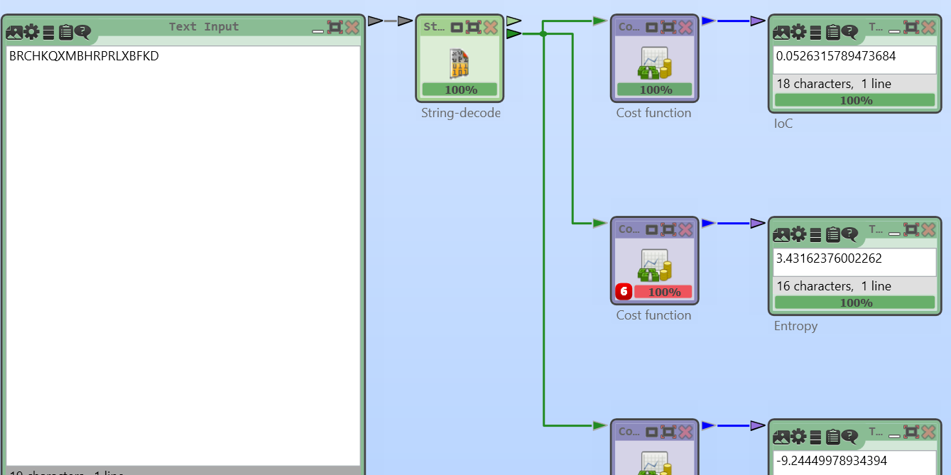
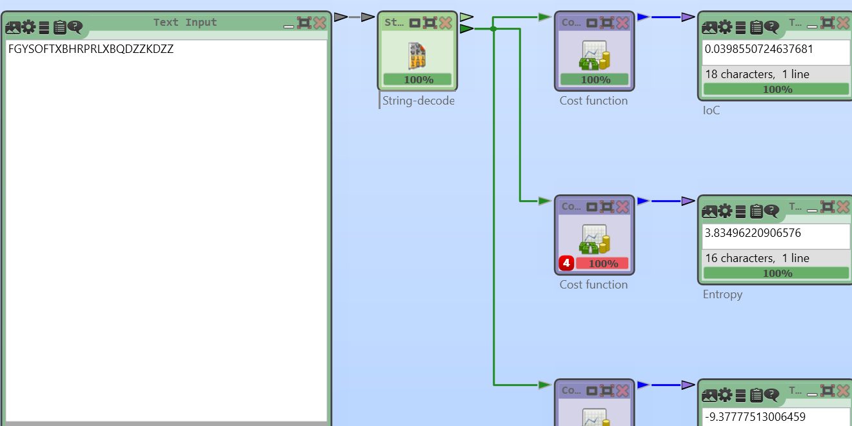
Experiment Screenshot
Index of Coincidence:-
Plaintext input:- INFORMATIONSYSTEM
Key input:- TEXT
EXISTING METHOD
PROPOSED METHOD

Slide 8
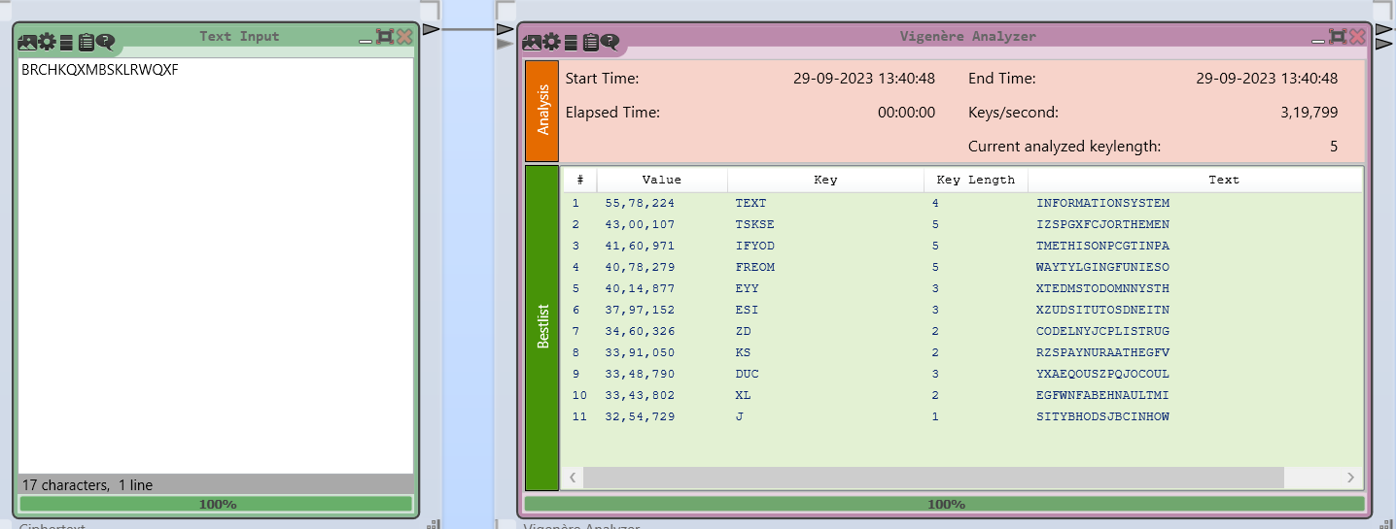
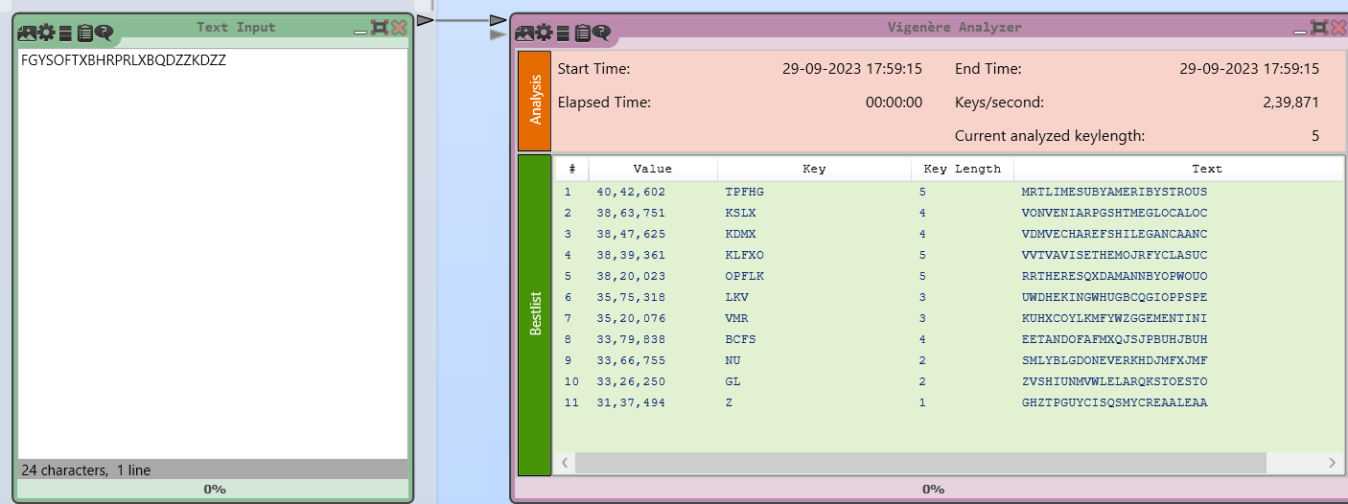
Experiment Screenshot
Frequency Analysis:-
Plaintext input:- INFORMATIONSYSTEM
Key input:- TEXT
EXISTING METHOD
PROPOSED METHOD

Slide 9
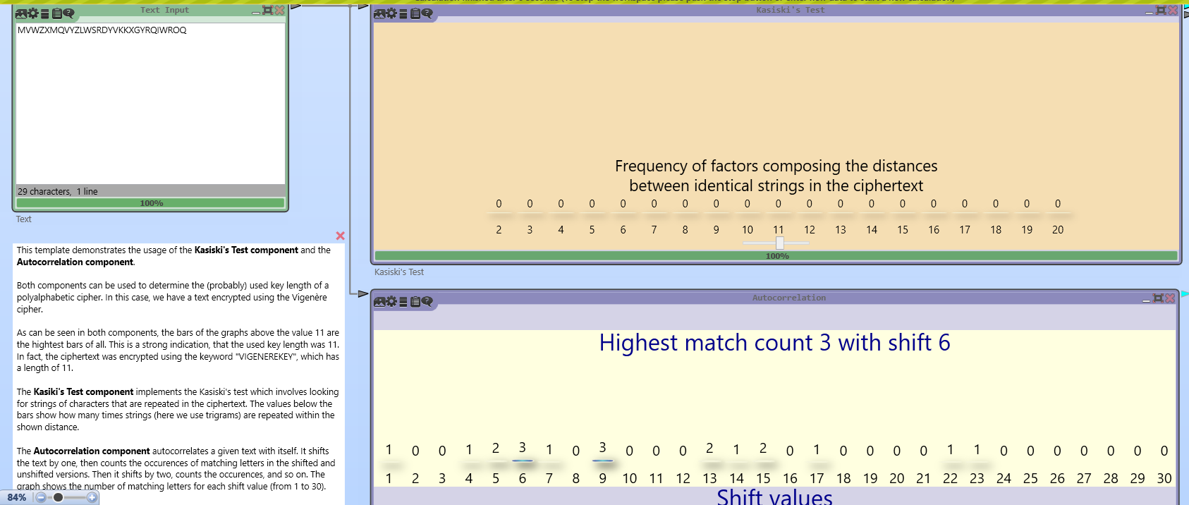
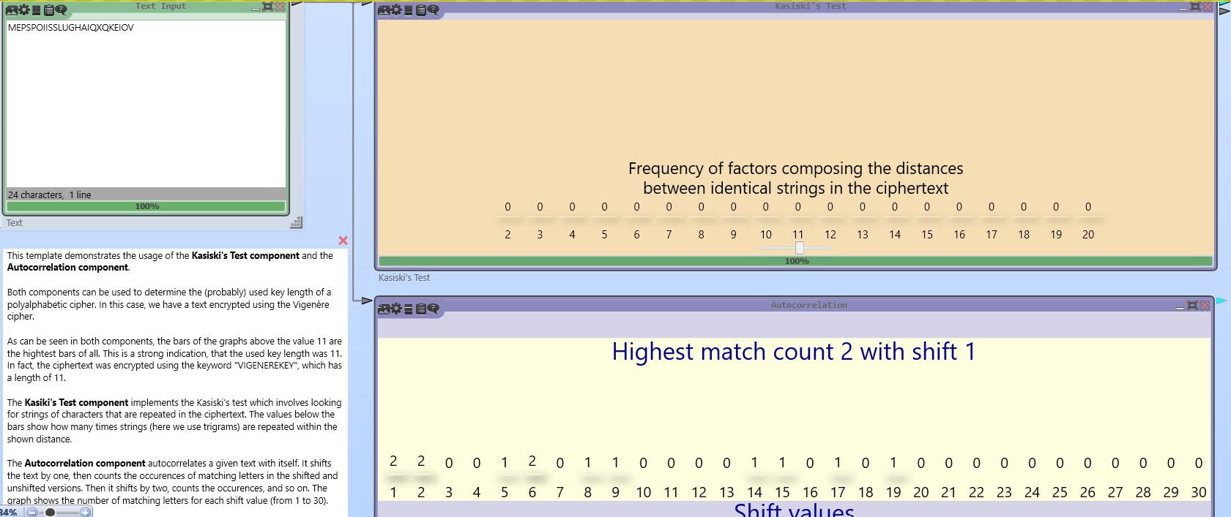
Experiment Screenshot
Kasiski Test:-
Plaintext input:- INFORMATIONSYSTEM
Key input:- KEY
EXISTING METHOD
PROPOSED METHOD

Slide 10
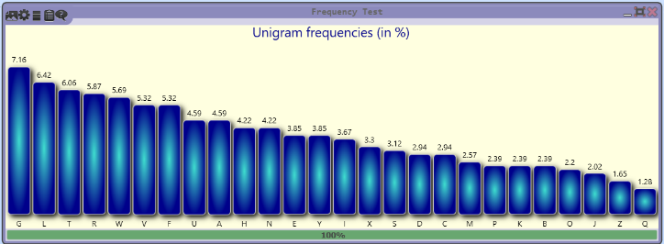
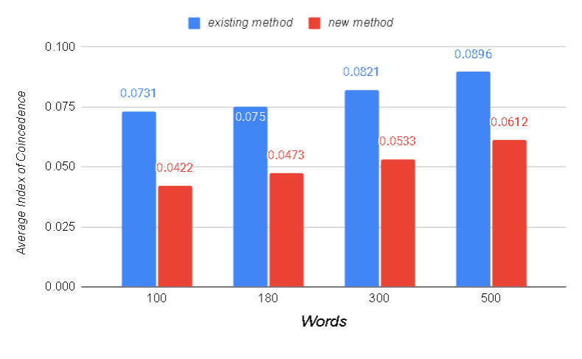
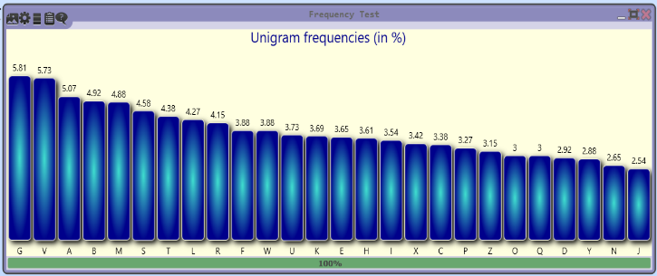
Experiment Results
Frequency Analysis using existing method
Index of coincidence
Frequency Analysis using proposed method

Slide 11
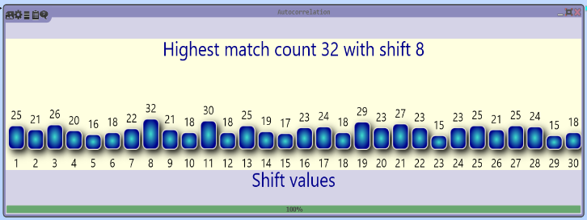
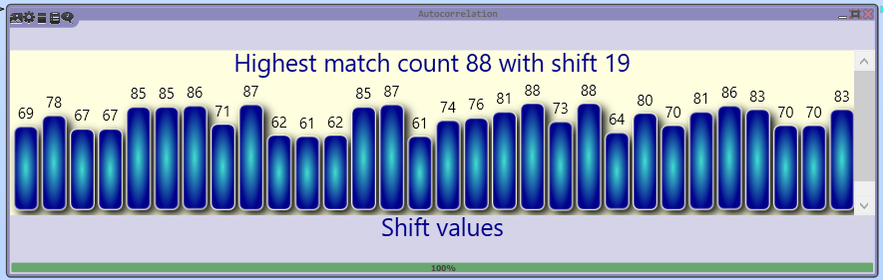
Experiment Results
Kasiski Attack using existing method
Kasiski Attack using proposed method

Slide 12
Finding
We found that our hybrid cryptography system is secure against frequency analysis attack, kasiski attack, and index of coincidence .
The concept of round key in this system has played a major roles to overcome the above attacks as it randomizes the key.
Due to extension of polybius square 5*5 grid to 8*8 grid, it has made difficult for an attacker to deduce the desired plaintext.
XOR operation performed on the ciphertext obtained from polybius encryption has provided and extra layer of security for polybius cipher.
Though the encryption and decryption time increases but it has overcome the attacks of Vigenere and Polybius cipher.

Slide 13

Justification
Parameters | Mathematical Formula | Existing Value | Improved Value | Justification
Index of coincidence |  | 0.0533 | 0.0247 | Index of coincidence reduced as the message was encrypted using round keys
Frequency Analysis Attack | count(group[i]) / total length of group | 0.69 | 0.26 | Frequency of letters is reduced due to randomization

